Slide 1
Data Management for Analytics
Presentation Report - Fall 2022
Northeastern University
Submission Date: December 9, 2022
Pharmacy Inventory Management
GROUP 11
SAI VARUN KUMAR NAMBURI
MEENAL

Slide 2

Business Problem
Efficient inventory management enhances gross profits and net profits by reducing the cost of procured pharmaceutical products and associated operational expenses. We are focusing on selecting appropriate fulfillment strategies that match the business’s size and the volume and type of orders it receives. Based on these strategies we can help the organization maintain an inventory that can ship products faster, minimize waste, and improve customer satisfaction which will help maintain the most effective workflow.
The model will include the data required for the day-to-day operations to help maintain information about the inventory. At a high level, this includes data about transactional data like receiving and shipping inventory, fulfilling orders, and managing inventory in warehouse space.
This model ensures that the product will be utilized before it expires and should help your organization to achieve greater efficiency and fulfill orders more accurately so you can do more at a lower cost.

Slide 3

Theory
Inventory management encompasses the principles and processes involved in running the day-to-day operations of a retailer. At a high level, this includes receiving and organizing inventory space, scheduling labor, managing inventory, and fulfilling orders. Zoom in closer and you’ll see that effective business management involves optimizing and integrating each of those processes to ensure all aspects of a warehouse operation work together to increase productivity and keep costs low.
In our project, we are going to track the movements of the drugs on a basis of day to day from warehouse to seller and to customer. We are going to record their Drug ID, Drug Name, Warehouse ID, expiry date, date of purchase, and how many items are left in the store. From the warehouse supplier, we are going to record the Warehouse ID, Warehouse Name, Drug ID, Count of the packs, expiry date, and date of arrival.
The process of the supply chain is recorded, the retail store needs to record the supplier’s ID, name, address, and city. For products, the company needs to know their ID, name, type, and available quantity. At the same time, the purchase price and delivery period of the products also should be recorded. Each time when a customer purchases a product from the store, they will generate an order number and corresponding product type, order time, quantity, and product price. In the background, it needs to verify if the stock of that product is less than the threshold, and it should be notified to the respective supplier and place order for the same.

Slide 4
Other Requirements
A warehouse can hold one to infinite orders to fulfill the inventory requirements. A supplier can supply to any number of stores in the city.
An inventory can sell one to infinite orders to the customers, the store can sell different drugs at a time.
We are going to have a master table that contains all the drug names and drug ids, these ids can be mapped to all the different tables.
Warehouse can contain products in bulk, which can be stored as Product Id, Product Names, quantity, and expiry date, this is used to handle the inventory orders.
Strengthening the relationships with the warehouse as well as customers
Ensuring resources are used optimally and without loss
Provide insight into inventory location and quantity using predefined rules for receiving, picking, and packing orders
Checking in and logging incoming items. Verify that you’re receiving the right quantity, in the right condition, at the right time.
Move items from the receiving dock to their correct storage locations.
Safely store and logically arrange inventory to enable fast and accurate picking collects the items needed to fulfill sales orders.
Prepare the picked items for shipment. They must be safely packed into the correct packaging with an accurate packing slip.
Send out the finalized sales orders, ensuring that they are on the right vehicle, at the right time, with the correct documentation, so customers receive their orders on time.

Slide 5
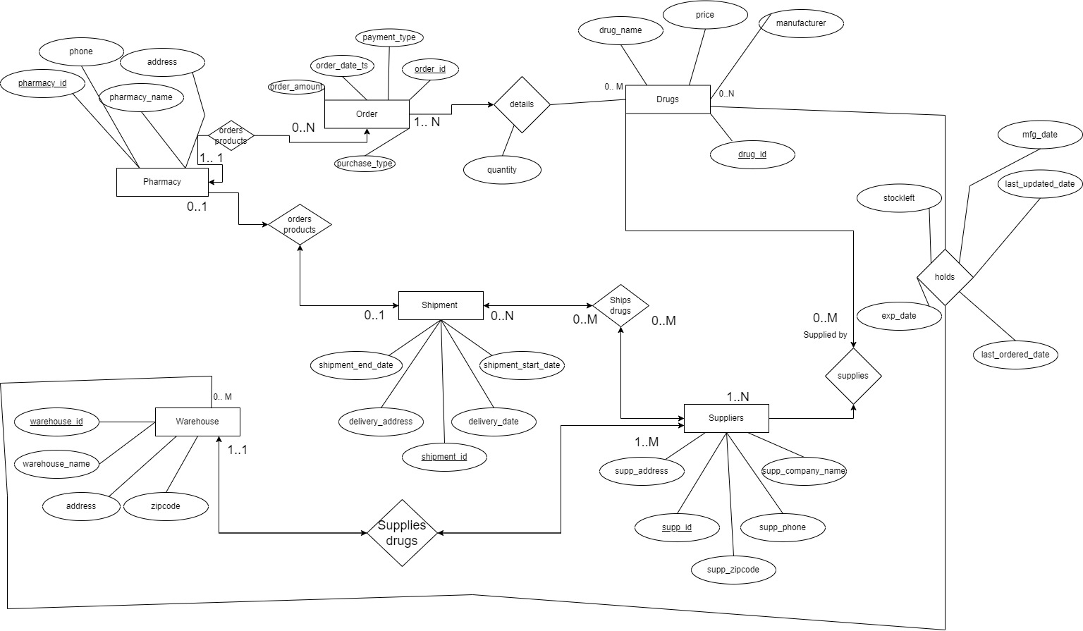
EER Model

Slide 6
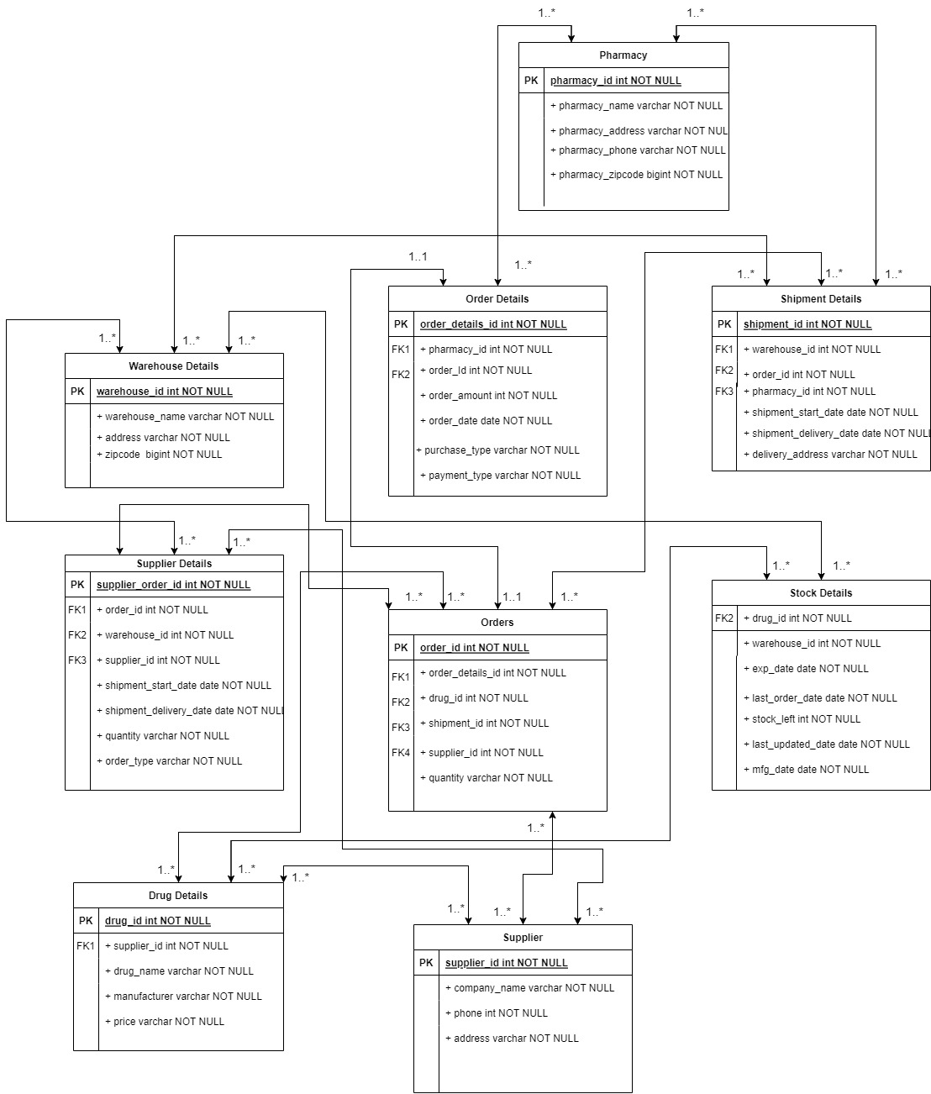
UML Class
Diagram

Slide 7
Logical Model
Tables with their respective syntax:
warehouse_id
ORDERS → (order_id, pharmacy_id, order_date, payment_type, total_amount)
ORDER_DETAILS → (order_id, drug_id, quantity)
STOCK_DETAILS → (drug_id, stock_left, last_ordered_date, last_updated_date, warehouse_id, mfg_date, exp_date)
SHIPMENT_DETAILS→(shipment_id, warehouse_id, shipment_start_date, order_id, shipment_end_date)
SUPPLIERS → (supplier_id, company_name, phone_no, address,)
DRUGS → (drug_id, drug_name, manufacturer, mrp_price, supplier_id)
WAREHOUSE_DETAILS → (warehouse_id, warehouse_name, address, zipcode)
PHARMACY → (pharmacy_id, pharmacy_name, address, phone_no)
Primary Key: Underlined with blue color
Foreign Key: Green color

Slide 8
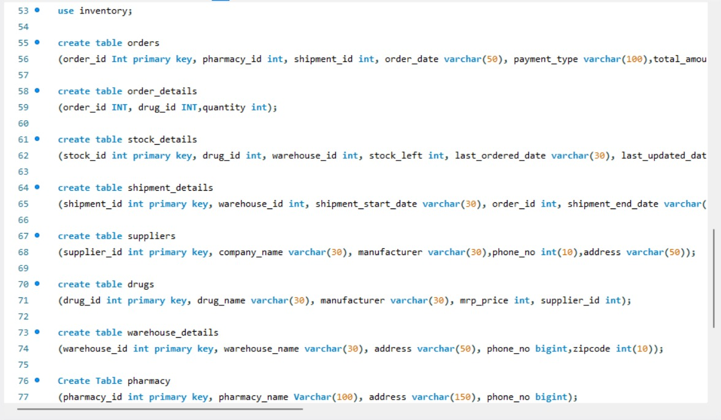
Implementation Model
show databases;
create database inventory;
use inventory;
create table orders (order_id Int primary key, pharmacy_id int, shipment_id int, order_date varchar(50), payment_type varchar(100),total_amount int);
create table order_details (order_id INT, drug_id INT,quantity int);
create table stock_details (stock_id int primary key, drug_id int, warehouse_id int, stock_left int, last_ordered_date varchar(30), last_updated_date varchar(30), mfg_date varchar(30), exp_date varchar(30));
create table shipment_details (shipment_id int primary key, warehouse_id int, shipment_start_date varchar(30), order_id int, shipment_end_date varchar(30));
create table suppliers (supplier_id int primary key, company_name varchar(30), manufacturer varchar(30),phone_no int(10),address varchar(50));
create table drugs (drug_id int primary key, drug_name varchar(30), manufacturer varchar(30), mrp_price int, supplier_id int);
create table warehouse_details (warehouse_id int primary key, warehouse_name varchar(30), address varchar(50), phone_no bigint,zipcode int(10));
Create Table pharmacy (pharmacy_id int primary key, pharmacy_name Varchar(100), address varchar(150), phone_no bigint);

Slide 9
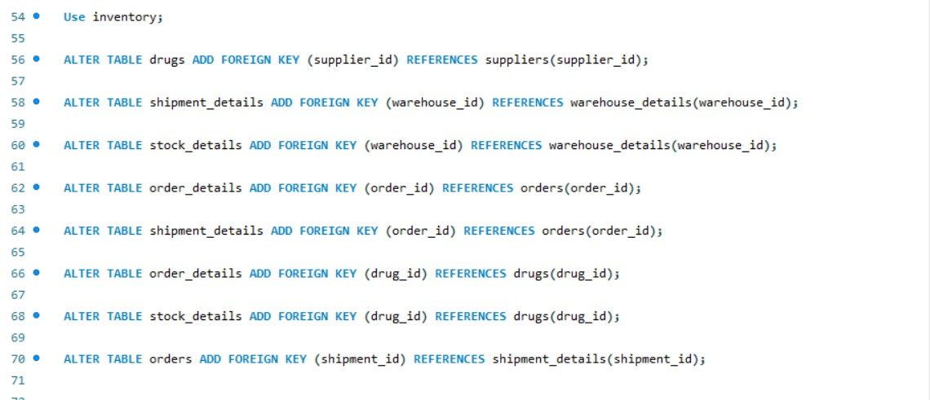
Creating Foreign Key relation for the Tables
ALTER TABLE drugs ADD FOREIGN KEY (supplier_id) REFERENCES suppliers(supplier_id);
ALTER TABLE shipment_details ADD FOREIGN KEY (warehouse_id) REFERENCES warehouse_details(warehouse_id);
ALTER TABLE stock_details ADD FOREIGN KEY (warehouse_id) REFERENCES warehouse_details(warehouse_id);
ALTER TABLE order_details ADD FOREIGN KEY (order_id) REFERENCES orders(order_id);
ALTER TABLE shipment_details ADD FOREIGN KEY (order_id) REFERENCES orders(order_id);
ALTER TABLE order_details ADD FOREIGN KEY (drug_id) REFERENCES drugs(drug_id);
ALTER TABLE stock_details ADD FOREIGN KEY (drug_id) REFERENCES drugs(drug_id);
ALTER TABLE orders ADD FOREIGN KEY (shipment_id) REFERENCES shipment_details(shipment_id);

Slide 10
Demonstration of SQL Queries

Slide 11
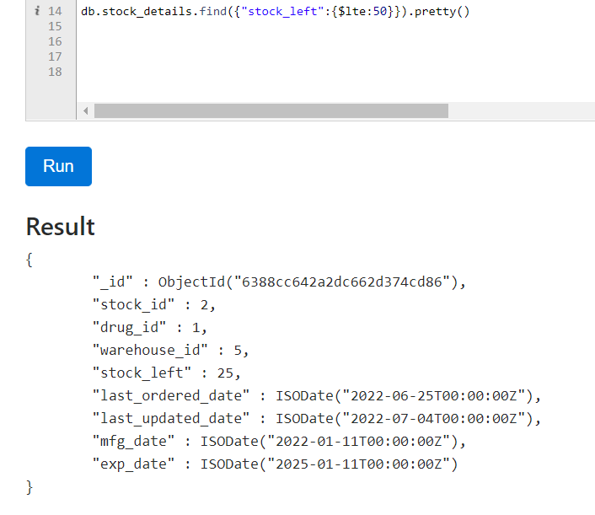
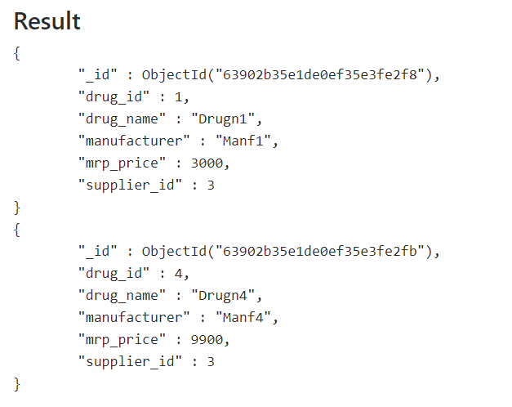
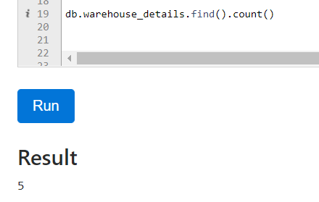
Queries NoSQL
FIND PRODUCTS THAT ARE LESS THAN 50 IN QUANTITY
DRUGS MANUFACTURED BY SUPPLIER NO 3
FIND NUMBER OF WAREHOUSES OWNED

Slide 12
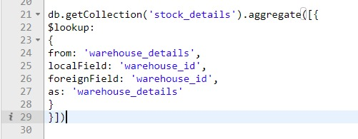
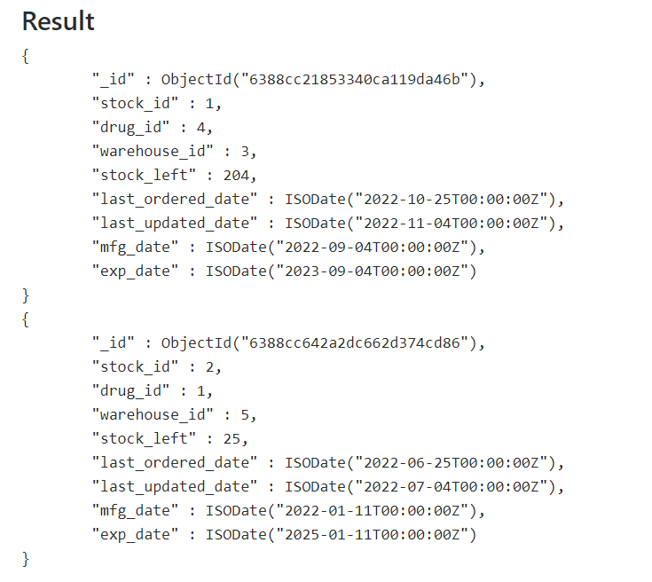
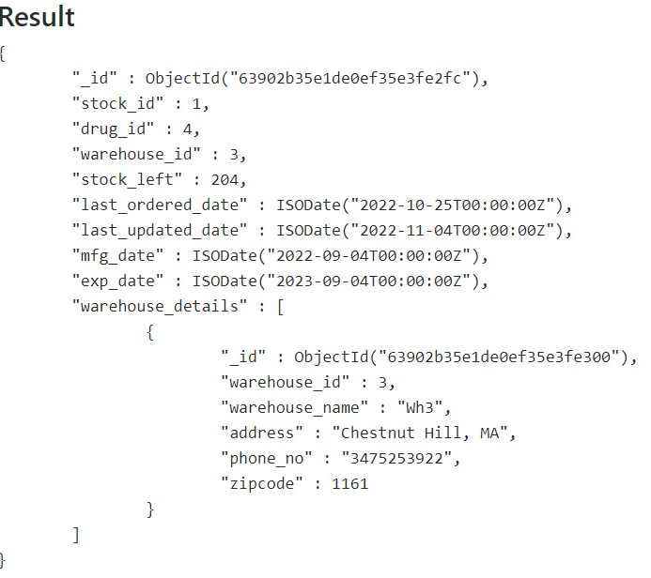
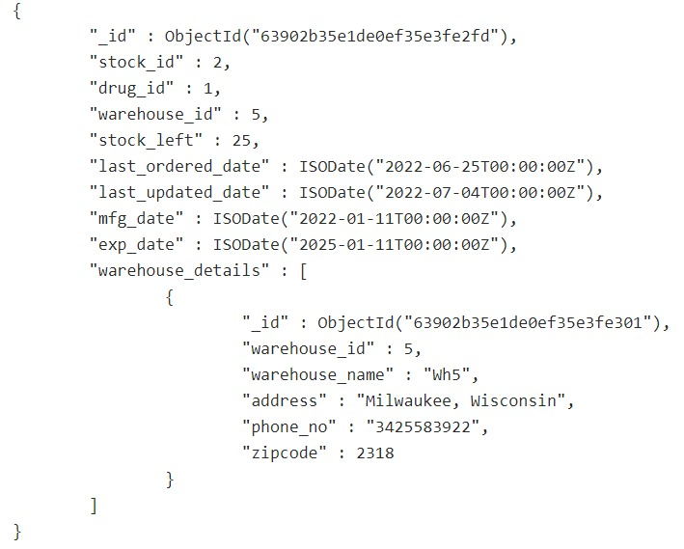
PRODUCTS ORDERED LAST BEFORE 30TH OCTOBER 2022
AVAILABILITY OF DRUGS IN WAREHOUSES

Slide 13
Python Application Demonstration

Slide 14


